Slide 1

CERTIFICATE III IN AUTOMOTIVE REPAIR & MAINTENANCE
SUBJECT: VEHICLE MAINTENACE AND REPAIR
By Ibrahim siraj
Maldives polytechnic

Slide 2
AUTOMOTIVE ENGINE PRACTICE
By Ibrahim siraj
Maldives polytechnic

Slide 3
VEHICLE MAINTENACE AND REPAIR
Chapter 12 Inspection and Service Brake System Components
What is car brake system
A car's brake system is a crucial safety feature that uses friction to slow down or stop the vehicle by converting its kinetic energy into thermal energy
It works by using hydraulic pressure to force brake pads against a spinning rotor (disc brakes) or brake shoes against a drum (drum brakes), which slows the wheels.
This system is operated by the driver pressing the brake pedal, which activates a master cylinder that pushes hydraulic fluid through lines to the individual brakes
By Ibrahim siraj
Maldives polytechnic

Slide 4
VEHICLE MAINTENACE AND REPAIR
Chapter 12 Inspection and Service Brake System Components
Main types of car brake system
Disc brakes, drum brakes, anti-lock braking systems (ABS), and regenerative braking
Disc brakes: A caliper uses pads to squeeze a rotating disc, creating friction to stop the wheel. They are known for providing strong stopping power and better cooling, making them common on the front wheels of most vehicles.
Drum brakes: Brake shoes push outward against the inside of a rotating drum, which is attached to the wheel. These are often more cost-effective and are frequently used on the rear wheels of some vehicles.
Anti-lock braking system (ABS): This is a safety feature that prevents wheels from locking up during hard braking, helping the driver maintain steering control and reducing skidding
Regenerative braking: Found in electric and hybrid vehicles, this system uses the motor to slow the vehicle and convert the kinetic energy back into electricity to recharge the battery.
By Ibrahim siraj
Maldives polytechnic

Slide 5
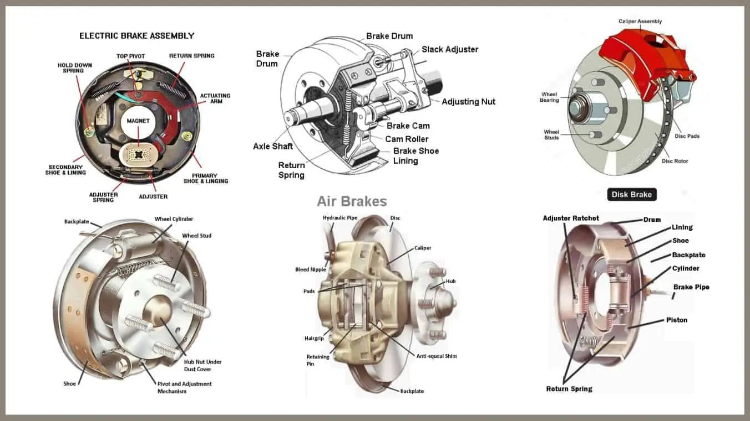
VEHICLE MAINTENACE AND REPAIR
Chapter 12 Inspection and Service Brake System Components
Main types of car brake system
By Ibrahim siraj
Maldives polytechnic

Slide 6
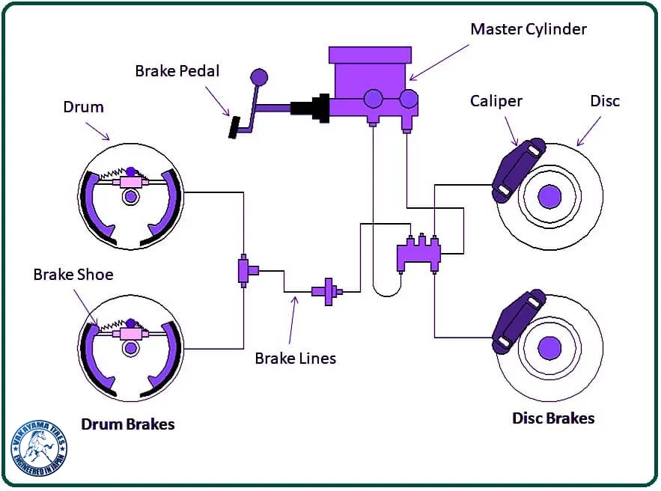
VEHICLE MAINTENACE AND REPAIR
Chapter 12 Inspection and Service Brake System Components
By Ibrahim siraj
Maldives polytechnic

Slide 7
VEHICLE MAINTENACE AND REPAIR
Chapter 12 Inspection and Service Brake System Components
Primary Braking Mechanisms (Service Brakes)
Disc Brakes: The standard for most modern passenger vehicles, especially on the front wheels due to their superior performance and heat dissipation.
Components: A rotor (disc) that rotates with the wheel, a caliper that houses brake pads, and pistons that press the pads against both sides of the rotor when the brake is applied.
Advantage: Better cooling, which reduces the risk of "brake fade" during heavy or continuous use.
Drum Brakes: Often used on the rear wheels of some vehicles due to their lower cost and simpler design. Components: A hollow brake drum, brake shoes, and wheel cylinders. When activated, the wheel cylinders force the brake shoes outward against the inner surface of the spinning drum.
Advantage: Cost-effective and good for emergency/parking brake integration, as they can be mechanically locked in place
By Ibrahim siraj
Maldives polytechnic

Slide 8
VEHICLE MAINTENACE AND REPAIR
Chapter 12 Inspection and Service Brake System Components
Key Components of a Car Brake System
Brake Pedal: The driver's input point, connected to the master cylinder.
Master Cylinder: Converts the force from the brake pedal into hydraulic pressure. Modern systems often use a tandem master cylinder for safety redundancy with two separate circuits.
Brake Fluid & Lines: The incompressible fluid (usually ethylene glycol-based) transmits the hydraulic pressure through lines and hoses to the wheel units.
Brake Booster (Servo): Uses engine vacuum or a separate pump to amplify the force applied by the driver to the pedal, making braking easier.
Brake Calipers: Found in disc brake systems, they house the brake pads and pistons. When hydraulic pressure is applied, the piston(s) push the pads against the rotor.
Brake Pads: Friction material that presses against the rotor (disc) to create friction and heat, which slows the wheel's rotation.
Brake Rotors (Discs): Metal discs that rotate with the wheel. The brake pads clamp down on them to generate the necessary stopping force.
Brake Shoes & Drums: Used in drum brake systems (often on rear wheels), where curved brake shoes are forced against the inner surface of a rotating drum.
Parking Brake: A separate, typically mechanical, system for holding the vehicle stationary.
By Ibrahim siraj
Maldives polytechnic

Slide 9
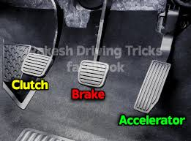
VEHICLE MAINTENACE AND REPAIR
Chapter 12 Inspection and Service Brake System Components
Brake Pedal
The brake pedal is the foot-operated lever in a vehicle that a driver presses to activate the braking system and cause the vehicle to slow down or stop
By Ibrahim siraj
Maldives polytechnic

Slide 10
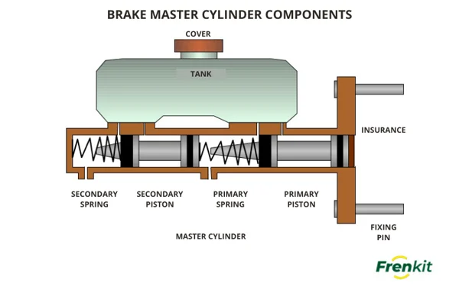
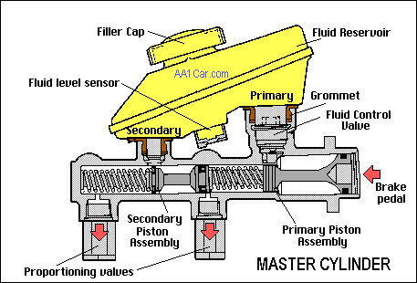
VEHICLE MAINTENACE AND REPAIR
Chapter 12 Inspection and Service Brake System Components
Master Cylinder
By Ibrahim siraj
Maldives polytechnic

Slide 11
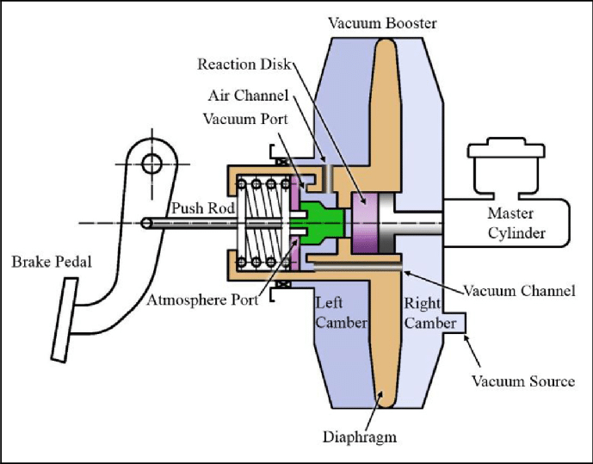
VEHICLE MAINTENACE AND REPAIR
Chapter 12 Inspection and Service Brake System Components
Brake Booster (Servo):
A brake booster (also called a brake servo) is a device that multiplies the force you apply to the brake pedal, making it much easier to stop your vehicle. It sits between your brake pedal and the master cylinder, effectively bridging the mechanical force of your foot with the hydraulic system of the brakes.
By Ibrahim siraj
Maldives polytechnic

Slide 12
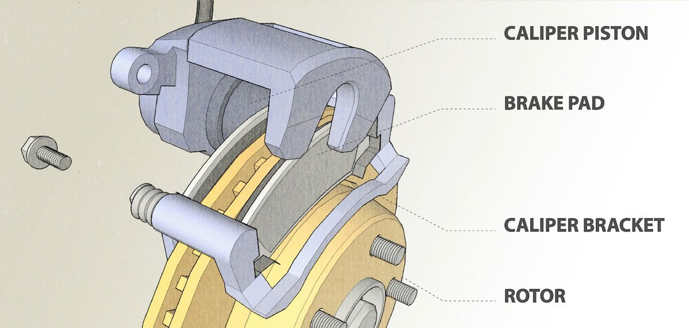
VEHICLE MAINTENACE AND REPAIR
Chapter 12 Inspection and Service Brake System Components
Brake Caliper
By Ibrahim siraj
Maldives polytechnic

Slide 13
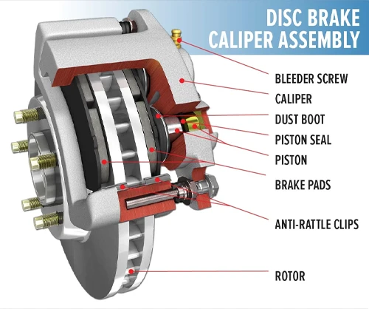
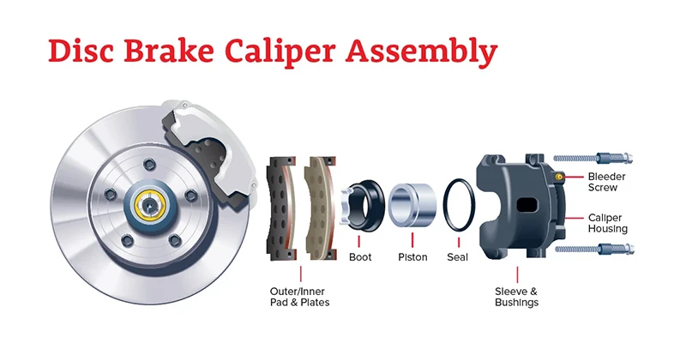
VEHICLE MAINTENACE AND REPAIR
Chapter 12 Inspection and Service Brake System Components
Brake Pad
By Ibrahim siraj
Maldives polytechnic

Slide 14
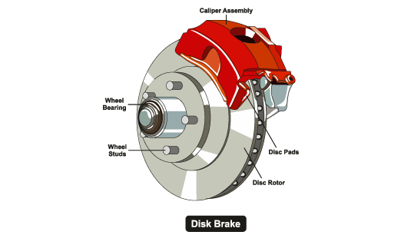
VEHICLE MAINTENACE AND REPAIR
Chapter 12 Inspection and Service Brake System Components
Brake Disc
By Ibrahim siraj
Maldives polytechnic

Slide 15
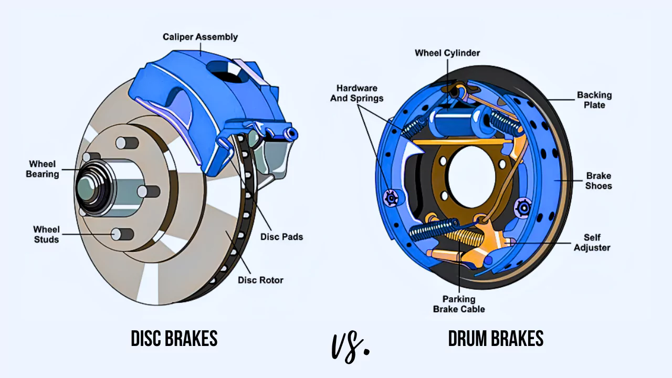
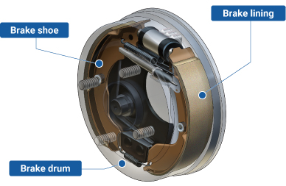
VEHICLE MAINTENACE AND REPAIR
Chapter 12 Inspection and Service Brake System Components
Brake Drum
By Ibrahim siraj
Maldives polytechnic

Slide 16
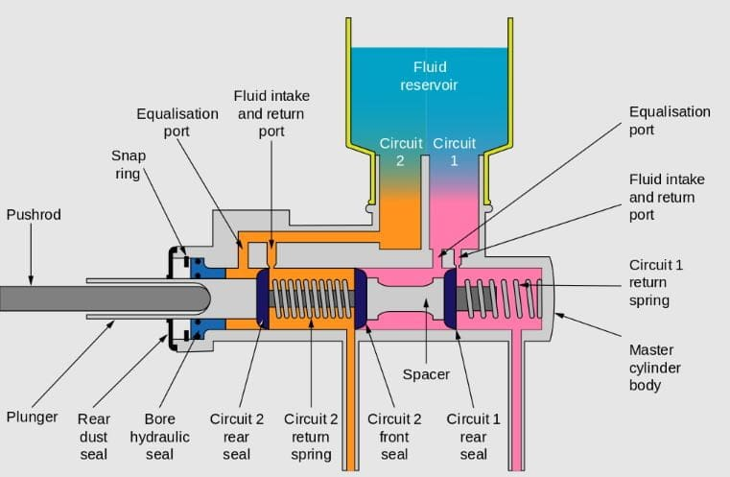
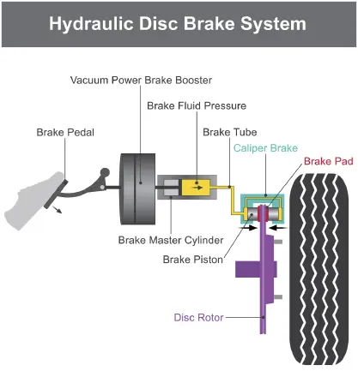
VEHICLE MAINTENACE AND REPAIR
Chapter 12 Inspection and Service Brake System Components
By Ibrahim siraj
Maldives polytechnic

Slide 17
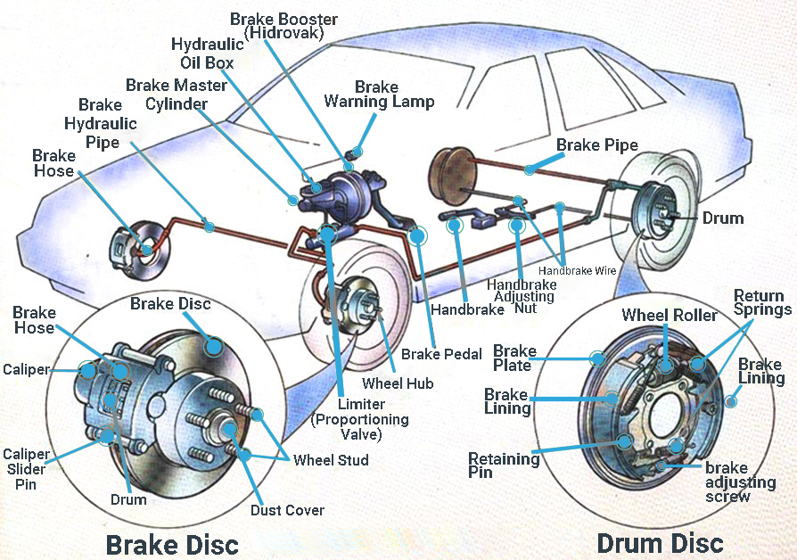
VEHICLE MAINTENACE AND REPAIR
Chapter 12 Inspection and Service Brake System Components
By Ibrahim siraj
Maldives polytechnic

Slide 18
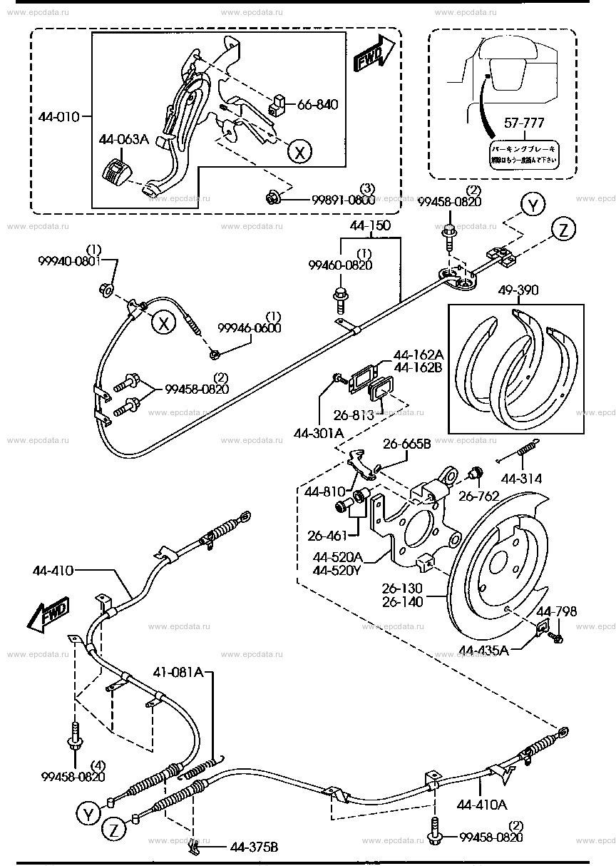
VEHICLE MAINTENACE AND REPAIR
Chapter 12 Inspection and Service Brake System Components
Introduction to Handbrakes
What is it? A secondary braking system that operates independently of the main hydraulic foot brakes.
Alternative Names: Parking brake, emergency brake, or e-brake.
Primary Purpose: To keep a vehicle stationary when parked, especially on inclines, and to serve as a backup if primary brakes fail.
By Ibrahim siraj
Maldives polytechnic

Slide 19
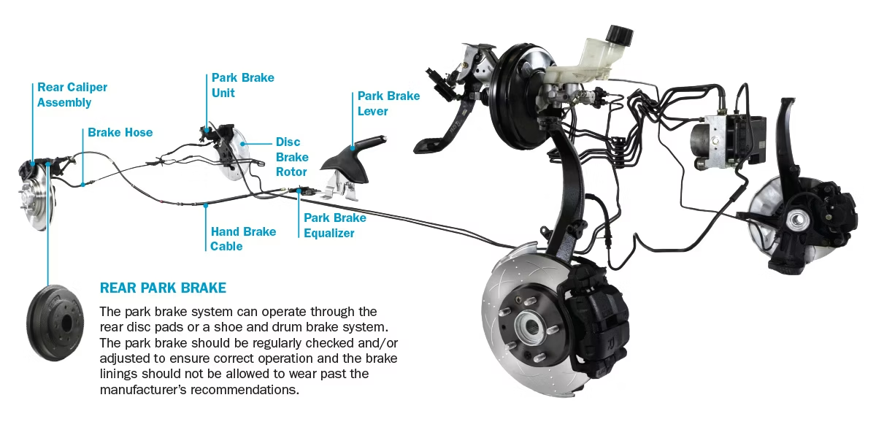
VEHICLE MAINTENACE AND REPAIR
Chapter 12 Inspection and Service Brake System Components
Introduction to Handbrakes
Hand Brake Main Component
Handbrake Lever/Switch: The driver interface (lever, pedal, or button).
Cable Assembly: Flexible steel cables that transmit physical force to the rear wheels.
Equalizer Yoke: A mechanism that ensures equal braking force is distributed to both rear wheels.
Adjusting Mechanism: Nuts or bolts used to maintain proper cable tension as components wear.
Rear Brake Interface: Connects to either drum brakes (brake shoes) or disc brakes (calipers/auxiliary drums).
By Ibrahim siraj
Maldives polytechnic

Slide 20
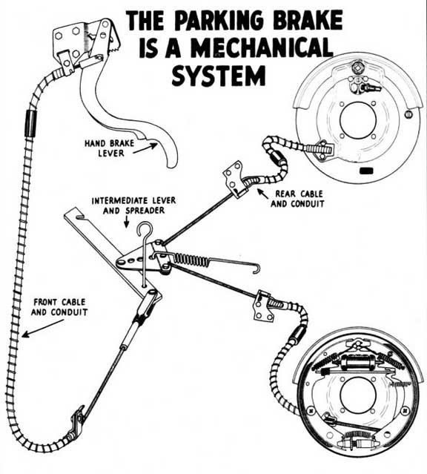
VEHICLE MAINTENACE AND REPAIR
Chapter 12 Inspection and Service Brake System Components
Introduction to Handbrakes
Hand Brake How It Works (Mechanical System
Engagement: Pulling the lever creates tension in the cable assembly.
Force Multiplication: The cable often passes through an intermediate lever to increase the pulling force.
Application: The cables pull on a lever at the rear wheels, forcing friction material (pads or shoes) against the disc or drum.
Locking: A spring-loaded pawl engages with a ratchet plate to hold the lever in the "on" position
By Ibrahim siraj
Maldives polytechnic

Slide 21
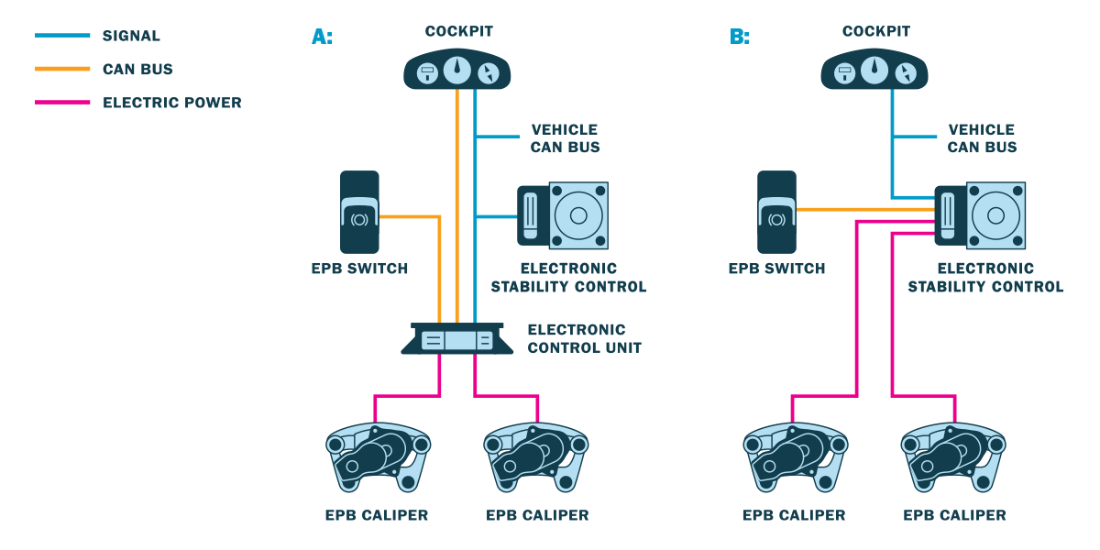
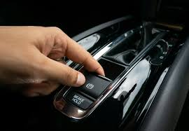
VEHICLE MAINTENACE AND REPAIR
Chapter 12 Inspection and Service Brake System Components
Introduction to Handbrakes
Hand Brake Modern Electronic Parking Brakes (EPB)
The Switch: Replaces the heavy lever with a dashboard or console button.
The Motor: Uses electric actuator motors located on the rear calipers to apply pressure.
The Brain: Controlled by the Electronic Control Unit (ECU) or ABS module, which checks ignition and pedal states before engaging or releasing.
Benefits: Saves cabin space, eliminates cable wear, and offers features like "Auto-Hold" or "Hill Start Assist"
By Ibrahim siraj
Maldives polytechnic

Slide 22
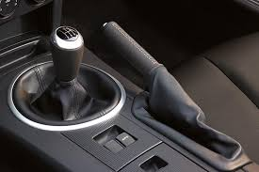
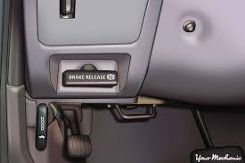
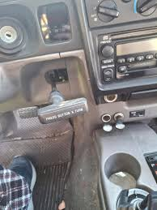
VEHICLE MAINTENACE AND REPAIR
Chapter 12 Inspection and Service Brake System Components
Introduction to Handbrakes
Hand Brake Common Types of Parking Brakes
Center Lever: The classic "stick" between front seats.
Foot Pedal: A small pedal on the far left of the footwell, common in older or automatic vehicles.
Stick Lever: A pull-type handle found under the dashboard in older models.
Push Button: The modern electronic standard.
By Ibrahim siraj
Maldives polytechnic

Slide 23
VEHICLE MAINTENACE AND REPAIR
Chapter 12 Inspection and Service Brake System Components
Introduction to Handbrakes
Hand Brake Best Practices for Usage
Always Engage: Use the parking brake every time you park to reduce strain on the transmission's parking pawl. a small, finger-like metal pin that locks the transmission output shaft.
Proper Technique: When applying a manual lever, it is best practice to hold the release button to prevent excessive wear on the ratchet teeth.
Hill Starts: Use it to prevent rollback on steep inclines while transitioning from the brake to the accelerator.
By Ibrahim siraj
Maldives polytechnic

Slide 24
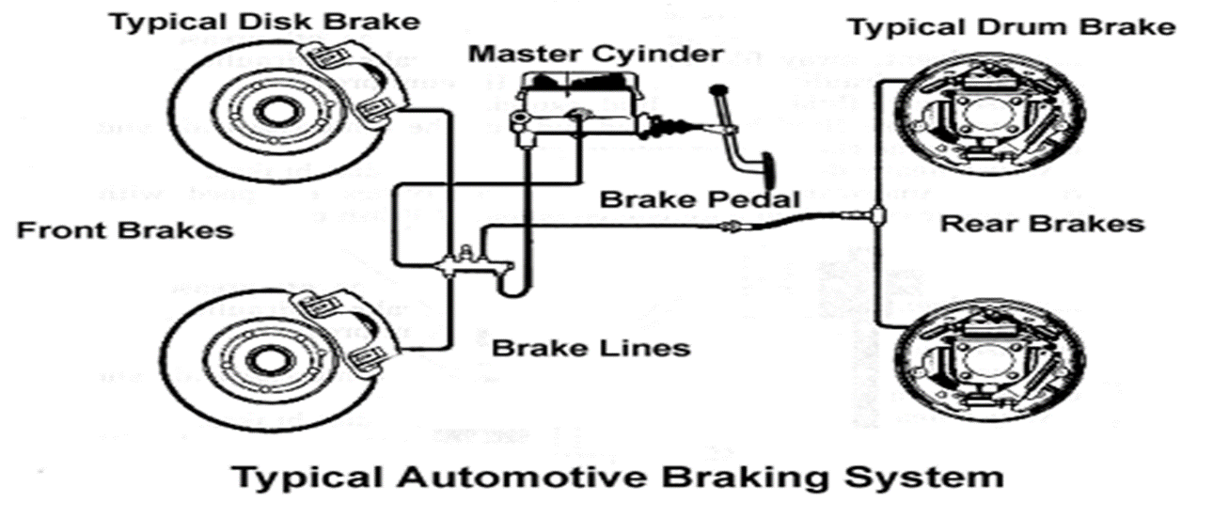
VEHICLE MAINTENACE AND REPAIR
Chapter 12 Inspection and Service Brake System Components
How brake system works
Input Force: When you press the brake pedal, a pushrod connected to it moves a piston inside the master cylinder.
Pressure Generation: As the piston moves, it compresses the brake fluid within the cylinder's bore, creating high hydraulic pressure.
Pressure Transmission: This pressurized fluid travels through brake lines to the slave cylinders (calipers or drum wheel cylinders) at each wheel.
Braking Action: The hydraulic pressure forces the brake pads or shoes against the rotating rotors or drums, creating the friction needed to slow the wheels.
Return: Once the pedal is released, internal return springs push the pistons back to their resting position, allowing the fluid to return to the reservoir.
By Ibrahim siraj
Maldives polytechnic

Slide 25
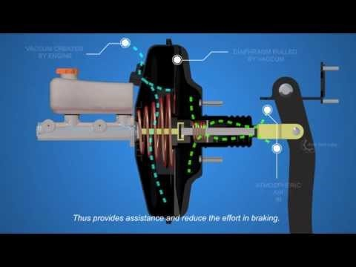
VEHICLE MAINTENACE AND REPAIR
Chapter 12 Inspection and Service Brake System Components
How brake system works
By Ibrahim siraj
Maldives polytechnic

Slide 26
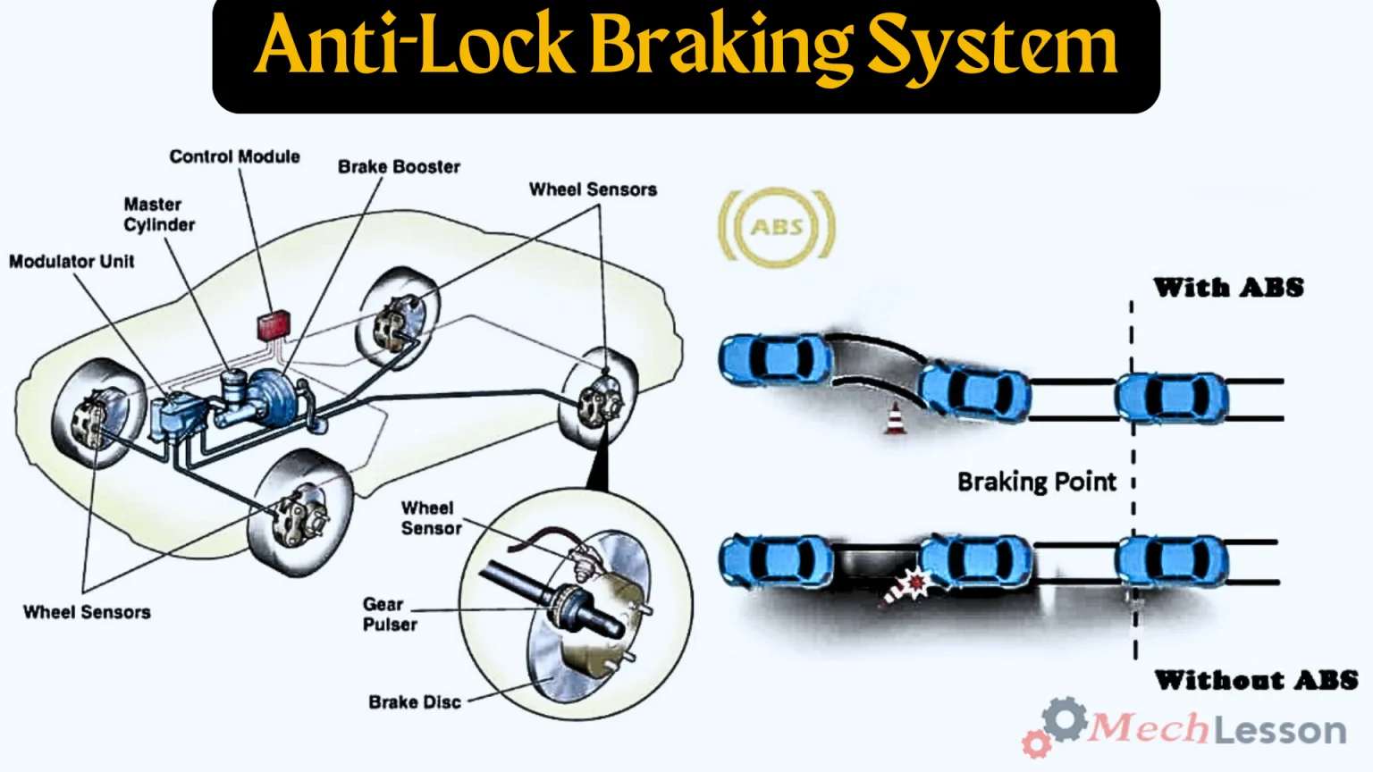
VEHICLE MAINTENACE AND REPAIR
Chapter 12 Inspection and Service Brake System Components
ABS Anti lock Brake System
Monitoring: Speed sensors at each wheel send real-time data to an Electronic Control Unit (ECU).
Detection: If the ECU detects a wheel is decelerating much faster than the others (indicating it's about to lock), it signals the ABS modulator.
Pressure Reduction: A hydraulic valve in the brake line temporarily reduces pressure to that wheel, allowing it to start spinning again.
Pressure Reapplication: Once the wheel regains traction, a pump restores hydraulic pressure. This cycle can happen up to 15–20 times per second
By Ibrahim siraj
Maldives polytechnic

Slide 27
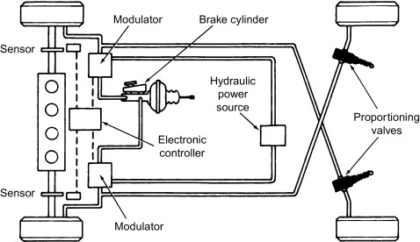
VEHICLE MAINTENACE AND REPAIR
Chapter 12 Inspection and Service Brake System Components
ABS Anti lock Brake System
Typical Configurations
Four-Channel, Four-Sensor: The most advanced and common setup in modern cars. It has a sensor and independent control valve for each wheel, offering the best steering control.
Three-Channel: Often found in older pickup trucks. It has independent sensors and valves for the front wheels but controls the rear wheels together.
One-Channel: Used in some older trucks and vans. It only monitors and controls the rear wheels as a single unit to prevent the back end from sliding out.
By Ibrahim siraj
Maldives polytechnic

Slide 28
VEHICLE MAINTENACE AND REPAIR
Chapter 12 Inspection and Service Brake System Components
ABS Anti lock Brake System
Common Symptoms of Failure
ABS Warning Light: The most direct indicator that the ECU has detected a fault and disabled the anti-lock feature.
Wheel Locking: If you brake hard and the wheels skid instead of pulsing, the system is not functioning.
Unusual Brake Pedal Feel: A "mushy" or unresponsive pedal, or unexpected pulsing during light braking, can signal a faulty ABS module or sensor.
Speedometer Glitches: Since the ABS module uses wheel speed sensors, a failure can sometimes cause erratic speedometer readings
By Ibrahim siraj
Maldives polytechnic

Slide 29
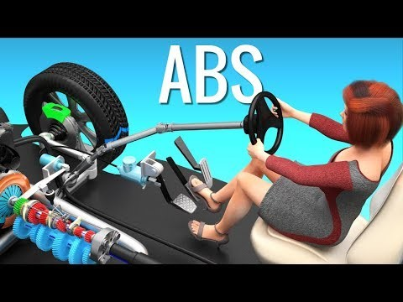
VEHICLE MAINTENACE AND REPAIR
Chapter 12 Inspection and Service Brake System Components
ABS Anti lock Brake System
By Ibrahim siraj
Maldives polytechnic

Slide 30
VEHICLE MAINTENACE AND REPAIR
Chapter 12 Inspection and Service Brake System Components
Common Brake Issues and Symptoms
Issue | Symptoms | Primary Causes
Worn Brake Pads | High-pitched squealing or screeching sound when braking. A deep grinding sound indicates metal-on-metal contact, meaning the pads are completely gone | Normal wear and tear over time; aggressive driving habits
Soft or Spongy Brake Pedal | The brake pedal feels "mushy," sinks to the floor, or requires excessive pressure to stop the car. | Air in the brake lines, low brake fluid, a fluid leak, or a faulty master cylinder.
Hard Brake Pedal | Takes a great deal of effort or pressure to push the pedal down and achieve normal braking. | A failure in the power brake booster system, a vacuum hose leak, or seized calipers.
Vibration/Pulsation | A shaking, juddering, or pulsating sensation in the brake pedal or steering wheel when braking. | Warped or uneven brake rotors (discs) caused by excessive heat buildup.
Car Pulling to One Side | The vehicle veers left or right when the brakes are applied. | Uneven brake pad wear, a stuck brake caliper, a collapsed brake line, or contaminated brake fluid on one side.
Burning Smell | A sharp, pungent chemical odor, especially after heavy braking. | Overheated brakes (brake fade) from excessive use, or a stuck caliper causing a pad to drag continuously on the rotor.
Brake Warning Light | An illuminated brake system or ABS (Anti-lock Braking System) light on the dashboard. | Low brake fluid levels, worn brake pads (if equipped with a sensor), or a problem with the ABS module/sensors.
Increased Stopping Distance | The car takes longer than usual to come to a stop. | Severely worn brake pads or rotors, or low brake fluid pressure.
By Ibrahim siraj
Maldives polytechnic

Slide 31
THANK YOU

